Slide 1
Control Flows in Programming

Slide 2
Control Flows Categories
The flow control statements are divided into three categories
Conditional statements
Iterative statements
Transfer statements

Slide 3
Conditional Statements
Condition statements act depending on whether a given condition is true or false.
One can execute different blocks of codes depending on the outcome of a condition.
Condition statements always evaluate to either True or False.

Slide 4
Conditional Statements
There are three types of conditional statements.
if statement
if-else
if- else if - else
nested if-else

Slide 5
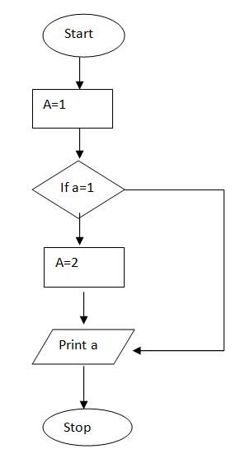
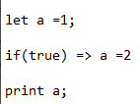
If statement

Slide 6
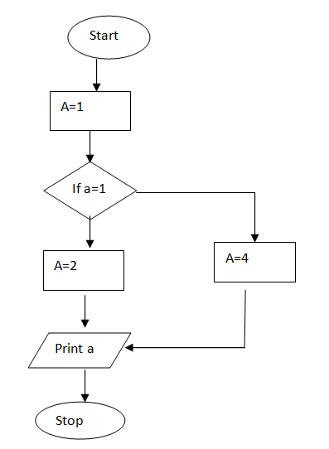
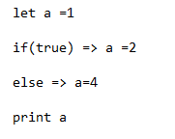
If-else

Slide 7
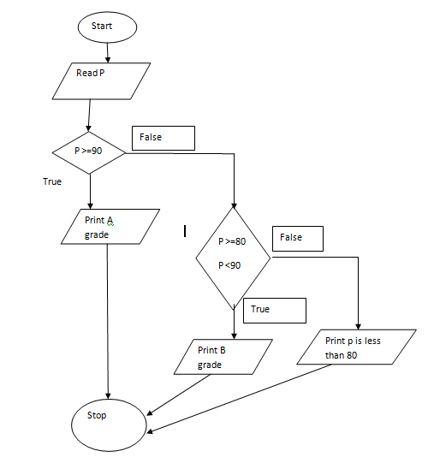
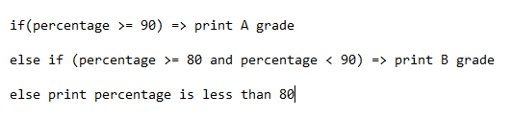
If - else if - else

Slide 8
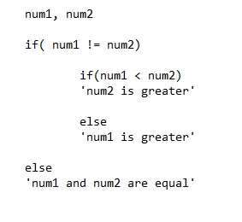
Nested if-else

Slide 9
Iterative Statements
Iterative statements allow us to execute a block of code repeatedly as long as the condition is True.
Also call it a loop statements.
Classified as following
‘for’ loop
while
do-while

Slide 10
For statement
for (statement 1; statement 2; statement 3) { // code block to be executed }
Statement 1 is executed (one time) before the execution of the code block.
Statement 2 defines the condition for executing the code block.
Statement 3 is executed (every time) after the code block has been executed.

Slide 11
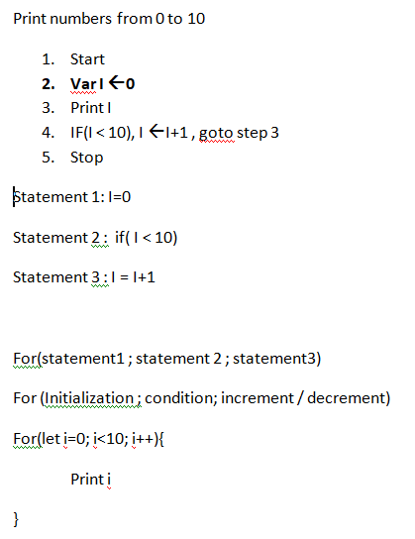

Slide 12
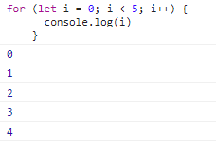
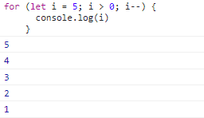
For loop

Slide 13
Transfer Statements
Transfer statements are used to alter the program’s way of execution in a certain manner.
For this purpose, we use three types of transfer statements.
break statements
continue statements
pass statements

Slide 14
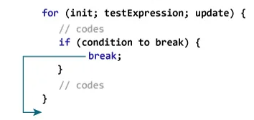
Break Statement
The break statement ends the loop immediately when it is encountered.

Slide 15
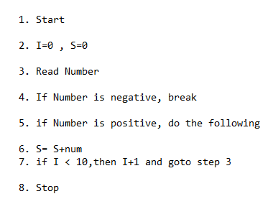
Break Statements
// Program to calculate the sum of numbers (10 numbers max)
//If the user enters a negative number, the loop terminates

Slide 16
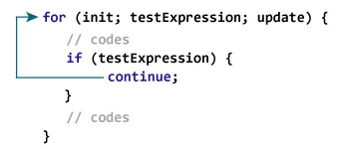
Continue Statement
The continue statement skips the current iteration of the loop and continues with the next iteration.

Slide 17
Switch Statements
A switch statement first evaluates its expression.
It then looks for the first case clause whose expression evaluates to the same value as the result of the input expression (using the strict comparison, ===) and transfers control to that clause, executing the associated statements.
(If multiple cases match the provided value, the first case that matches is selected, even if the cases are not equal to each other.)

Slide 18
